Slide 1
Artificial Intelligence and Machine Learning
Dr. Abdelhameed Ibrahim
Assoc. Prof. of Computer Engineering

Slide 2


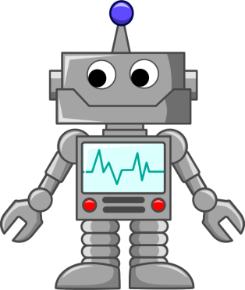




What is Artificial Intelligence
Input: Data Sensors Images
Artificial Intelligence
Output: Action Movement Text

Slide 3
What is Artificial Intelligence
In general, it is the ability for a machine to perform tasks that would normally require a person to do.
And just like people, it’s the ability to take information, make decisions based on it and cause an action to be taken.
Such as moving an arm, creating and image or text, or providing a suggestion.

Slide 4
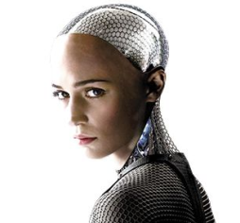
Types of Artificial Intelligence
Artificial Superintelligence: An intellect that is much smarter than the best human brains in practically every field, including
scientific creativity,
general wisdom and
social skills

Slide 5

Types of Artificial Intelligence
Artificial General Intelligence: A machine with the ability to apply intelligence to any problem, rather than just one specific problem (human-level intelligence)

Slide 6
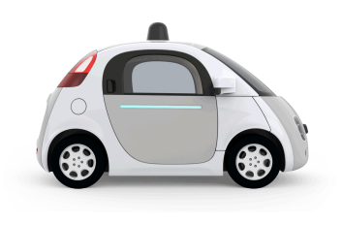
Types of Artificial Intelligence
Artificial Narrow Intelligence: Machine intelligence that equals or exceeds human intelligence or efficiency at a specific task

Slide 7
Subsets of Artificial Intelligence
Artifical
Artificial Intelligence
Machine Learning is a subset of Artificial Intelligence
Machine Learning
Deep Learning
Deep Learning
is a subset of
Machine Learning

Slide 8
What is Machine Learning
Type of Artificial Intelligence that provides computers with the ability to learn without being explicitly programmed
Various techniques can be used to for it learn make predictions based on data

Slide 9
What is Machine Learning
Training Data
Machine Learning Algorithm
Training
Prediction
“Live” Data
Trained Model
Prediction

Slide 10
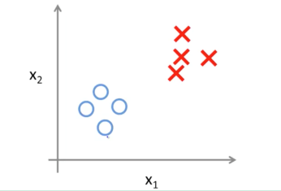
Machine Learning Approaches
Supervised Learning: Learning with a labelled training set
Example: email spam detector with training set of labelled emails

Slide 11
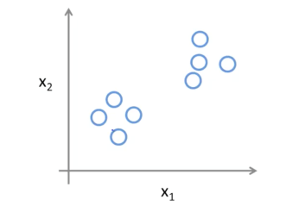
Machine Learning Approaches
Unsupervised Learning: Discovering patterns in unlabelled data
Example: cluster similar documents based on the text content

Slide 12
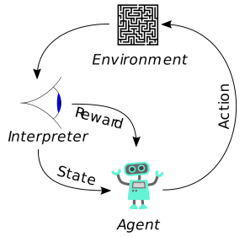
Machine Learning Approaches
Reinforcement Learning: learning based on feedback or reward
Example: learn to play chess by winning or losing

Slide 13
What is Deep Learning
Part of the machine learning field of learning representations of data.
Utilizes learning algorithms that derive meaning of day by using hierarchy of multiple layers that mimic the neural network of our brain
If you provide the system with tons of information it begins to understand it and respond in useful ways.

Slide 14
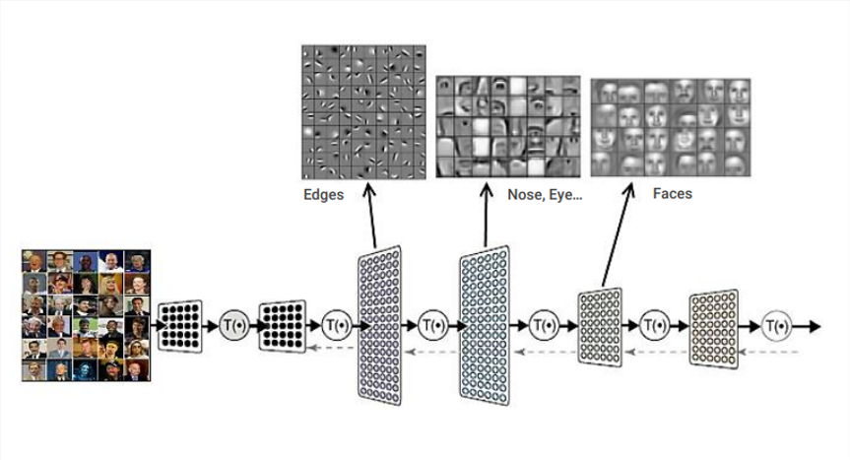
What is Deep Learning

Slide 15
What Machine Learning can do
INPUT A | RESPONSE B | APPLICATION
Picture | Are there human faces? (0 or 1) | Photo tagging
Loan Application | Will they repay the loan? (0 or 1) | Loan approvals
Ad plus user information | Will user click on ad? (0 or 1) | Targeted online ads
Audio clip | Transcript of audio clip | Speech recognition
English Sentence | French Sentence | Language translation
Sensor from plane engine, etc | Is it about to fail? | Preventive maintenance
Car camera and other sensors | Position of other cars | Self-driving cars

Slide 16
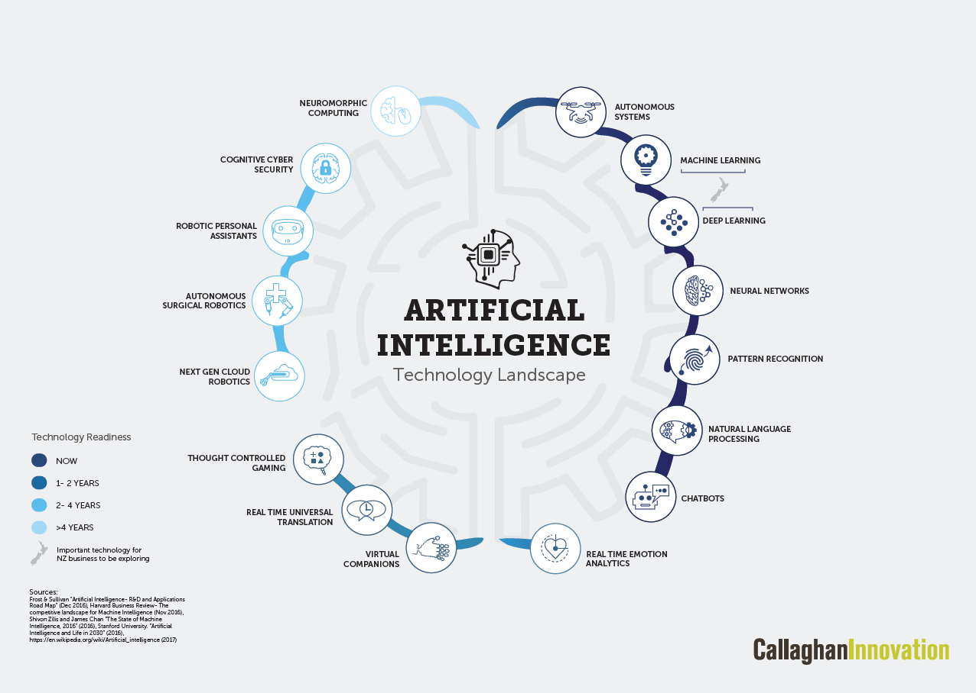
How to get started

Slide 17
Keys to a successful AI/ML project
Clear business need (what problem is it solving?)
Define specific project/product (How will you know it works?)
Find the data (lots of it)
Build or find tool/model (build or buy)
Test and adjust (use interactions to keep improving it)

Slide 18
Thank you!

